Slide 1

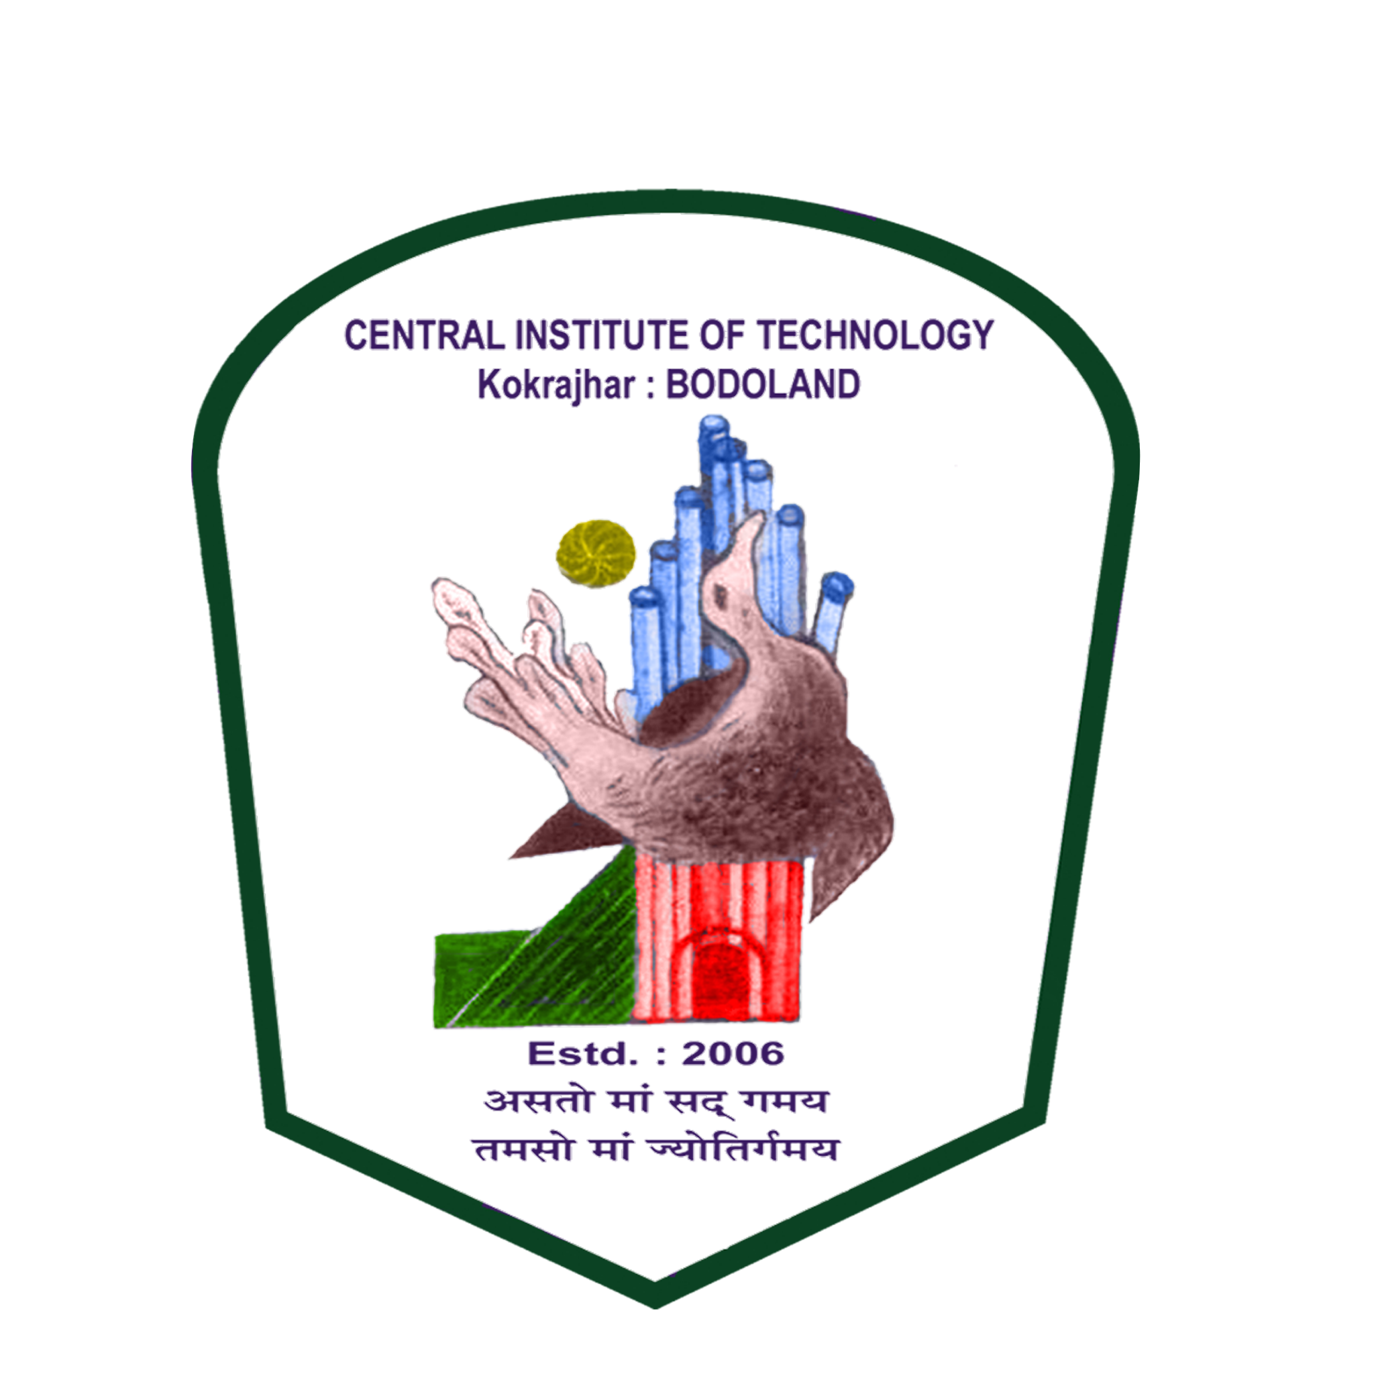
OCR-Enhanced Word Document Generation from Images
APT Software Avenues Pvt. Ltd.
Central Institute Of Technology Kokrajhar
Internship Project Presentation
Presented By
Rahul Son Boro
Presented By
Rahul Son Boro

Slide 2
Contents
01
Introduction: The Problem & My Solution
05
Results
02
The Conversion Pipeline: How It Works
06
Impact & Future Vision
03
Key Features & Differentiators
07
Q&A / Thank You
04
System Architecture & Tech Stack

Slide 3
Introduction: The Problem & My Solution
The Problem:
Information is trapped in images.
Standard OCR loses all formatting.
Tables and code are broken.
My Solution:
Intelligent two-stage conversion pipeline.
Preserves structure, tables, and code.
Creates fully formatted, editable documents.

Slide 4
The Conversion Pipeline: How It Works
Stage 1:
Stage 2:
Image to Markdown
Markdown to DOCX
Input: Starts with any image or PDF.
Analyze: PP-StructureV3 understands document layout.
Extract: Identifies text, tables, and images.
Output: Generates a structured Markdown file.
Parse: Custom converter reads the Markdown.
Reconstruct: Rebuilds content with rich formatting.
Apply Styles: Adds headings, code blocks, etc.
Output: Creates a polished, editable DOCX file.

Slide 5
Key Features & Differentiators
High-Fidelity Table Reconstruction.
Full Syntax Highlighting for Code.
Dynamic Mermaid Diagram Rendering.
Preserves Complex Document Structures.
Creates Polished, Ready-to-Edit Documents.

Slide 6
System Architecture & Tech Stack
Architecture
Tech Stack
Two-Stage Pipeline Design
Stage 1: Image Analysis & OCR
Stage 2: Document Generation
Analysis Engine: PaddleOCR (PP-StructureV3)
DOCX Generation: python-docx
Parsing: BeautifulSoup & python-markdown
Syntax Highlighting: Pygments

Slide 7
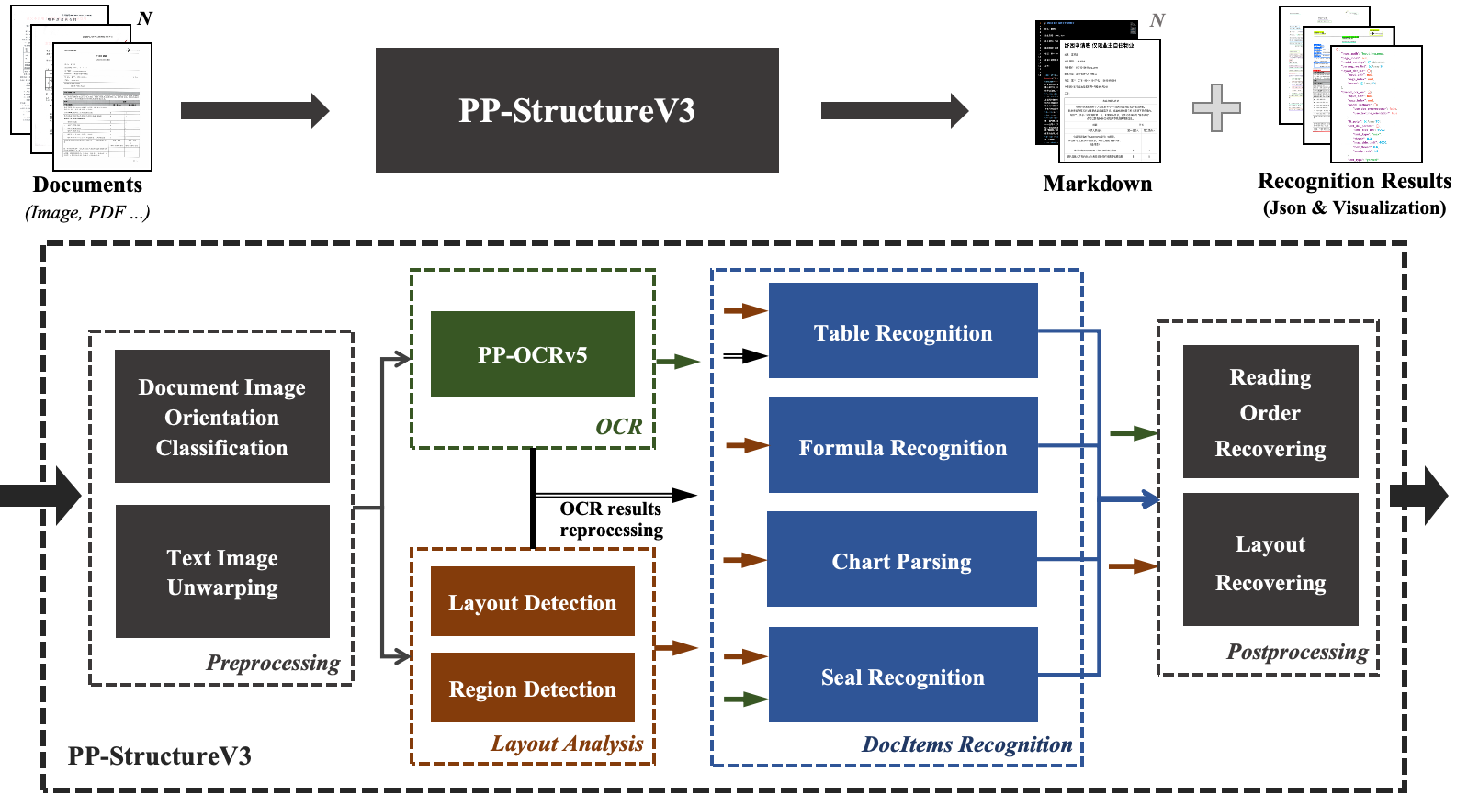
PP-StructureV3 Figure:

Slide 8
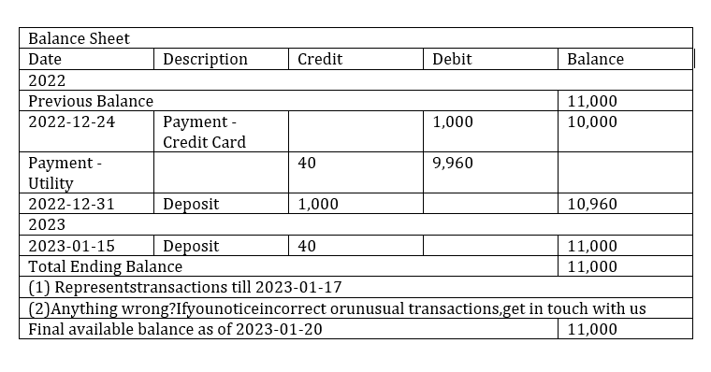
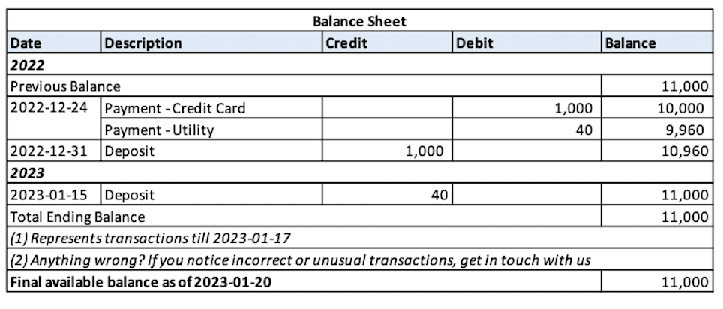
Results
Fig: Input Image
Fig: Output Image

Slide 9
Impact & Future Vision
Impact:
Automates tedious manual conversion work.
Unlocks critical data from static images.
Boosts efficiency and improves data accuracy.
Makes document content searchable and reusable.
Future Vision:
Enhance table recognition for complex merges.
Implement support for editable math equations.
Develop a simple user interface (GUI) for easy use.
Enable batch processing for large document sets.

Slide 10
Q&A / Thank You

